Slide 1
The Legislative/Executive Authority & The County Road Department
February 2023

Slide 2
Introductions and Questions
CRAB Staff Introductions
Questions? Please contact CRAB Staff if you have any questions on the material presented.

Slide 3
Agenda and Training Materials
Participants were provided with a workbook and referred to the Desk Reference Manual. You can find a link below this video on our web site.
Orange text indicates a direct effect on, direct action of, or action involving the legislative/executive authority
Blue text indicated an active hyperlink to Stautes, Rules or Resources
Session 1
Laws and Rules
County Road Administration Board (CRAB)
CRAB WACs, Standards of Good Practice and Required Reporting
Office of County Engineer
Road Purpose
Session 2
Review and Lead In
Color of Money
Property Tax, Fuel Tas and Other Major Revenues
Funding Programs: RAP, CAP, CFCIP and ELP
Repeating Calendar
Wrap Up and Questions

Slide 4
Standards of Good Practice
Laws and Rules:
The Legislative/Executive Authority
& the County Road Department

Slide 5
Washington Administrative Code (WAC)
Commonly referred to as WAC
Rules adopted by the CRABoard to implement the duties assigned to CRAB by the Legislature.
All CRAB WAC’s are under Chapter 136 WAC – County Road Administration Board
WAC 136-01 to 136-04: CRAB General Organization and Policies
WAC 136-11 to 136-70: Standards of Good Practice
WAC 136-100 to 136-210: Rural Arterial Preservation Program
WAC 136-300 Series: County Arterial Preservation Program
WAC 136-400 Series: County Ferry Capital Improvement Program
WAC 136-500 Series: Emergency Loan Program
WAC 136-600 Series: Equipment Rental and Revolving Fund (ER&R)

Slide 6
Standards of Good Practice
Codified in Washington Administrative Code Section 136-11 to 136-70
Compliance with the standards of good practice allows counties to receive motor vehicle fuel tax from the state.
All involve the County Engineer’s Office. About half require the county’s legislative authority to take action.
One standard of good practice also requires the county Auditor and Sheriff to certify traffic law enforcement expenditures.

Slide 7
County Engineer’s Office Only
136-11 – Maintenance Management
Requires asset management, annual work program and budget, work accomplishment and expenditure shall be monitored
136-18 – County Forces Construction
Limits the $$$ that a county can do CAPITAL projects with county employees
136-20 – Inspection of Bridges
All structures over 20.0ft inspected every 24 months.
136-28 – Accident Reports
Provide WSDOT with accident location information for county roads
136-40 – Accommodation of Utilities
Requires a utility accommodation policy
136-60 – County Road Logs
Submit county road log by April 1st. Used to determine how much MVFT and CAPA funds each county will receive.
136-70 – Pavement Management
Requires all paved collectors and arterials to be rated at least every two years.

Slide 8
WAC 136-12 - Vacancy or Change in Position of County Engineer
Requires the legislative authority to notify CRAB of a vacancy or change in the county engineer within FIVE days of effective date and steps that will be taken to fill the position.
Requires the appointment of an acting county engineer during the recruitment process.
Can divide tasks – Engineering tasks must be a licensed professional civil engineer.
Notify CRAB when the position is filled.
CRAB is available to assist counties in the selection process.
Review the job description
Provide interview questions
Participate in the interviews

Slide 9
WAC 136-14 - Priority Programming
Requires the legislative authority to use a system to prioritize capital projects.
At the county’s discretion what that prioritization process is.
However, needs to factor in:
Traffic volumes Roadway Condition Matters of Significant Local Importance
Geometrics Safety and Accident History
Can be one system county wide, or can be multiple rankings for various improvement priorities such as bridges, safety, ADA accommodation, etc.
Used when the legislative authority updates and approves the six-year transportation program.

Slide 10
WAC 136-15 - Six Year Program
Each county must adopt a six year transportation program.
Legislative authority needs the priority array(s) and the annual bridge condition report provided by the county engineer’s office.
Required to hold a public hearing on the proposed program.
Must be adopted prior to approval of the annual construction program and budget for the upcoming year.

Slide 11
WAC 136-16 - Annual Construction Program & Report
The county engineer must submit a recommended annual road con- struction program to the legislative authority by October 1st of each year.
Includes road and bridge construction and all road equipment purchases for the ensuing year.
Can take the form of a report or details in the preliminary budget – as long as it is clear to all parties and the public.
Must be adopted prior to budget adoption. Amendments require unanimous vote of legislative authority present for the meeting
The adopted construction program must be submitted to CRAB by December 31st of each year.
Counties must also submit an annual construction report to CRAB by April 1st of the following year detailing what work was performed and actual costs of items of work.

Slide 12
WAC 136-25 - Traffic Law Enforcement
To be eligible for CRAB’s Rural Arterial Program, counties can only use diverted road levy funds for traffic law enforcement in the unincorporated area. Counties under 8,000 in population can use diverted road levy for any purpose in the unincorporated area.
This includes direct transfer of road fund and reimbursement of documented TLE expenditures.
Loss of RAP eligibility means the canceling of all current RAP contracts and reimbursement of any RATA funds used on those projects.
Because of the potential loss of RAP eligibility if the diversion is done incorrectly, CRAB recommends counties use a levy shift or direct reimbursement to assist with traffic law enforcement expenses.

Slide 13
WAC 136-25 - Traffic Law Enforcement Allowable Activities
Speed limit and other traffic law enforcement;
Collision investigation documenting/reporting;
Oversize vehicle (weight, length, width, and height) enforcement;
Special traffic emphasis patrols;
Facilitating the removal of abandoned vehicles from the county road and rights of way;
Facilitating the removal of roadway and right of way obstructions at the request of the county engineer;
Investigating illegal littering and dumping on county road rights of way;

Slide 14
WAC 136-25 - Traffic Law Enforcement Allowable Activities (cont’d)
Sign damage investigation and enforcement;
Road condition enforcement, including mud, water, debris, or spills;
Rights of way encroachment investigation and enforcement at the request of the county engineer;
Maintenance and construction zone traffic enforcement;
Road department vehicle special collision investigation at the request of the county engineer; and
Other activities clearly related to county road law enforcement needs, as mutually agreed upon in writing by the county road engineer and the county sheriff. Disagreements shall be elevated to the county legislative authority.

Slide 15
WAC 136-50 - Adoption of Written Policies
Requires county road departments to have the following policies in place:
Organization (Usually an approved org chart)
Complaint Handling (To ensure citizen complaints receive prompt attention)
Work for Other Agencies and Departments
County road standards
Survey monument preservation
Policies and any updates are to be submitted to CRAB

Slide 16
WAC 136-50 – Adoption of Written Policies
Requires county road departments to have the following policies in place:
Organization (Usually an approved org chart)
Personnel Practices (Typically a countywide handbook)
Complaint Handling (To ensure citizen complaints receive prompt attention)
Work for Other Agencies and Departments
Accommodation of Utilities in the County Road Right-of-Way
Policies and any updates are to be submitted to CRAB

Slide 17
Reporting to CRAB – Three Key Dates
December 31st – What you plan to do next year
March 1st – Current year’s adopted county road levy
Road levy diversion resolution
April 1st – What you did last year

Slide 18
Reporting to CRAB – Dec 31st Plans for Next Year
Annual Construction Program
County Arterial Preservation Program
Pavement Management Certification
County Road Budget Summary
Maintenance Management Work Plan
Adopted 6-year Transportation Program

Slide 19
Reporting to CRAB – March 1st Road Levy Details
What is the adopted county road levy for the year
Includes details such as:
Road district valuation
Highest lawful road levy
Any levy shift, diversion, or payment of traffic law enforcement from the county road fund
The actual road levy amount adopted by the legislative authority
Any banked levy capacity to be carried forward in future year

Slide 20
Reporting to CRAB – April 1st What Did You Do?
Traffic law enforcement certification
Fish passage barrier expenditures
Annual construction report
Annual county arterial preservation program report
Annual certification
Maintenance management certification
Expenditures of marine navigation and moorage (Island and San Juan Only)
Annual ferry system operations report

Slide 21
Reporting to CRAB – April 1st County Road Log
CRAB shall maintain a master road log of all 39 counties
How did your road system change last year?
Road log manager submits all changes to control fields last year
Surface type, road and shoulder width, traffic counts, number of bridges, etc.
Must include supporting documentation
Used to calculate the portion of the Motor Vehicle Fuel Tax (MVFT) and County Arterial Trust Account (CAPP) each county will receive
These allocation factors are adopted by the CRABoard at the July meeting for use in the following calendar year
Road log must be signed and certified by the county engineer

Slide 22
Rural Arterial Program (RAP) County Arterial Preservation Program (CAPP) County Ferry Capital Improvement Program (CFCIP) Emergency Loan Program (ELP)
Office of the County Engineer

Slide 23
Office of the County Engineer
Q: Why is there an Office of the County Engineer?
A: Because the State of Washington says so!
RCW 36.75.020 – All things county road are the responsibility of the legislative authority under the supervision and direction of the county engineer.
County commissioners were originally road district commissioners!
RCW 36.80.010 – The legislative authority shall employ a county road engineer
RCW 36.80.020 – Must be a licensed professional civil engineer and shall serve at the pleasure of the Board

Slide 24
Office of the County Engineer – The Relationship Distilled
The Legislative Authority
Sets policy
Sets the budget
Sets level of service
Reviews the County Engineer’s performance
Receives regular updates
The County Engineer
Implements policy
Leads and manages the department
Manages personnel and budget
Reports regularly to the Legislative Authority

Slide 25
Office of the County Engineer
The person holding the title of County Engineer is:
A public official, and
A professional engineer, and
A member of a county department, and
The Office of the County Engineer is more than one person!
Oversight and quality control
All regulated activities and procedures are based on
the protection and use of the county road fund

Slide 26
Office of the County Engineer – Statutory Duties
RCW 36.80.015 – Office at the county seat
RCW 36.80.020 – Duly qualified and experienced in highway and road engineering and construction
RCW 36.80.030 – Certify to the Board and has authority over all estimates and all bills for labor, materials, provisions, and supplies
RCW 36.80.040 – Office of the County Engineer is an office of record
RCW 36.80.050 – Shall ensure that a highway plat record is kept and publicly accessible

Slide 27
Office of the County Engineer – Statutory Duties (cont’d)
RCW 36.80.060 – Maintain and has authority over complete and accurate records of all expenditures for:
Administration
Bond and warrant retirement
Maintenance
Construction
Purchase and operation of road equipment
Purchase or manufacture of materials and supplies
Maintain a true and complete inventory of all road equipment
RCW 36.80.070 – All road construction work in accordance with plans and specifications prepared by or under the direct supervision of the county road engineer.

Slide 28
County Road Levy
Road Purpose

Slide 29
County Road Levy – Property Tax
Based on the appraised value property
Levy
Verb – The act of imposing taxes, assessments, or charges
Noun – The total amount of taxes, assessments, or charges imposed by the government
Rate – The rate necessary to raise an amount of revenue. Typically, in dollars and cents per $1000 of assessed value
Limit – The restriction on the amount that a district’s tax levy may increase over the highest lawful levy since 1985
Lid-Lift – A ballot measure authorizing the district to increase their levy rate beyond the levy limit

Slide 30
County Road Levy – Property Tax (cont’d)
Revenue collected as a result of property taxes is highly regulated with specific limitations
Maximum rate allowed per $1000 of assessed value
Current Expense - $1.80
County Road - $2.25
Levy shift – Current expense and county road can’t be more than $4.05. More on levy shifts later.
Department of Revenue
“Operations Manual – Property Tax Levies”

Slide 31
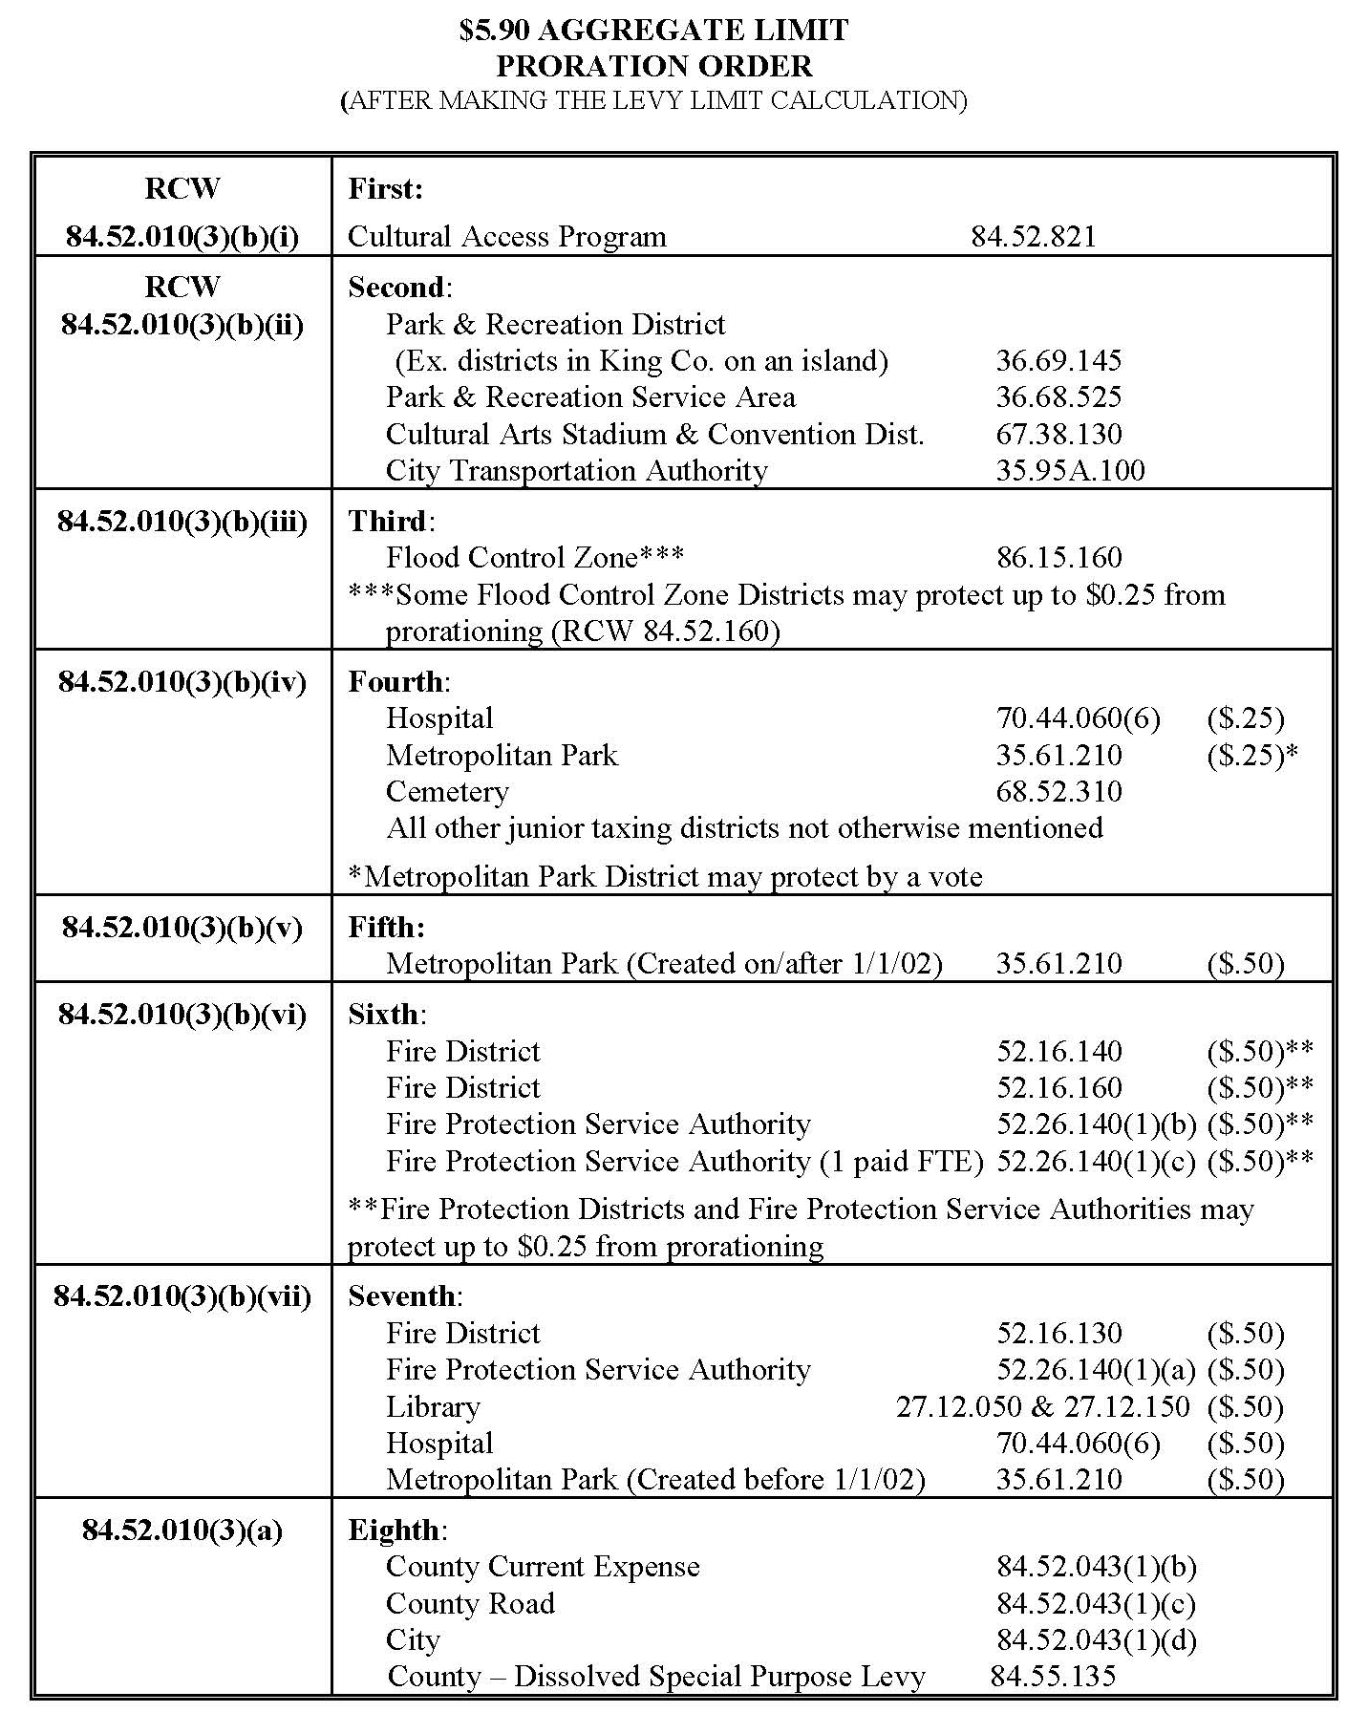
County Road Levy

Slide 32
County Road Levy – Levy Shift
The “shifting” of taxing authority from the road district (unincorporated area) to the current expense levy (Incorporated and unincorporated areas)
Current expense cannot exceed a rate of $2.475 after the levy shift
Current expense and county road levies combined cannot exceed $4.05
A levy shift cannot harm any other taxing district – cannot lead to proration
The shift is a specific dollar amount converted into a rate
Shifting $1,000,000 of levy capacity from county road to current expense
Funds from the levy shift can be used for ANY allowable county expense

Slide 33
County Road Levy – Levy Road Diversion
The Legislative Authority directs the county Treasurer to “divert” a specific dollar amount from the collected county road levy BEFORE it is deposited in the road fund.
The diverted funds can be used for any county purpose in the unincorporated area of the county
This does not include general services provided countywide such as Assessor, Treasurer, Corrections, Prosecuting Attorney, etc.
Seems straight forward, but there is a catch that could cost your county millions….

Slide 34
County Road Levy – Road Levy Diversion (cont’d)
RCW 36.79.140 – Rural Arterial Program Eligibility
If a county diverts all or a portion of the county road levy, the diverted funds can only be used for traffic law enforcement (WAC 136-25) or a county will lose its eligibility to participate in the Rural Arterial Program.
If a county is found to have used diverted funds, all open RAP contracts are immediately terminated and the county shall payback any RAP funds received on those contracts.
Exemption – Counties under 8,000 in population. Diverted funds must still only be used in the unincorporated area.

Slide 35
County Road Levy – Traffic Law Enforcement
Always a difficult choice for the Legislative Authority to use resources intended for county road to support traffic law enforcement.
If it must be done, we recommend:
If possible, make a levy shift your preferred option. Revenue can be used for any county purpose and no penalty.
If a levy shift can’t work, use direct reimbursement. Sheriff will have to provide transparent documentation of expenses and reviewed by the Office of the County Engineer. The Legislative Authority then knows what services it is receiving for its funds.
Only use diversion if no other option will work. The penalty for implementing and administering the diversion can be severe. And county road is who gets punished – not the other county entities that handled the diversion incorrectly.

Slide 36
2404 Chandler Court SW, Suite 240 Olympia, WA 98502 360.753.5989 crab.wa.gov
Jane Wall
Executive Director jane.wall@CRAB.wa.gov
360.350.6078
Drew Woods, PE
Deputy Director drew.woods@CRAB.wa.gov
360.753.5989
Derek Pohle, PE
Support, Training and derek.pohle@CRAB.wa.gov
Compliance Manager 360.350.6082
Steve Johnson, PE
Grants Program steve.johnson@CRAB.wa.gov
Manager 360.350.6081
Mike Clark, CET
Road Systems mike.clark@CRAB.wa.gov
Inventory Manager 360.350.6084

