Slide 1
The Legislative/Executive Authority & The County Road Department
February 2023

Slide 2
Rural Arterial Program (RAP) County Arterial Preservation Program (CAPP) County Ferry Capital Improvement Program (CFCIP) Emergency Loan Program (ELP)
Funding Programs

Slide 3
Rural Arterial Program (RAP)
What is the Rural Arterial Program?
Created in 1983 by the Washington State Legislature (RCW 36.79)
Funded with 2.5363% of the State fuel tax, per RCW 46.68.090 (2)(j)
Regionally competitive grant program
Used for a variety of project types to improve rural arterial or collector county roads and bridges

Slide 4
Rural Arterial Program (RAP)
Who can use the Rural Arterial Program?
WAC 136-150-030
All counties with population of 8,000 or less are eligible.
All other counties must meet funding requirements
Traffic Law Enforcement Certification
Fish Passage Barrier Expenditures
Marine Navigation and Moorage
If you are fulfilling the reporting requirements that ensure your county is utilizing road funds for allowable expenses, then you are eligible to use the Rural Arterial Program.

Slide 5
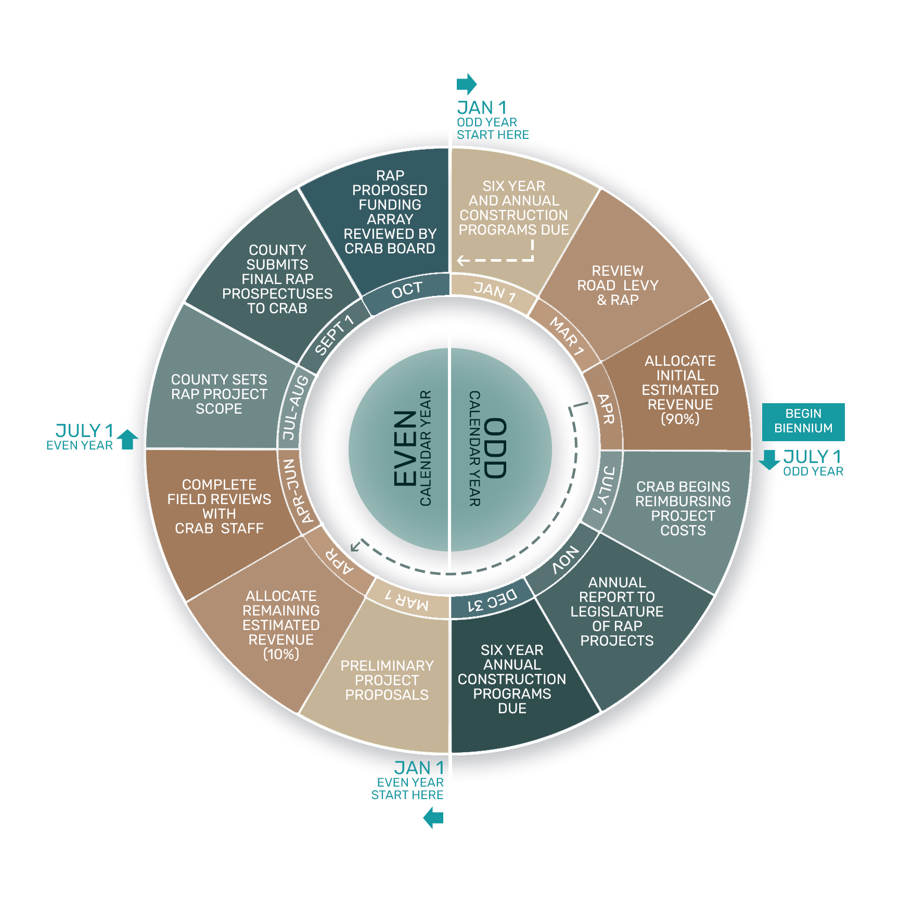
Rural Arterial Program (RAP)
RAP Biennium Cycle

Slide 6
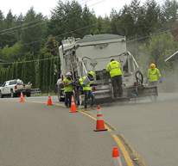
County Arterial Preservation Program (CAPP)
What is the County Arterial Preservation Program?
Created in 1990 by the Washington State Legislature (RCW 46.68.090)
Funded with 1.9565% of the State fuel tax, per RCW 46.68.090 (2)(i)
Funds are distributed directly to counties based on their proportion of paved county arterial roads
Allowable work is specifically limited to pavement preservation and associated activities

Slide 7
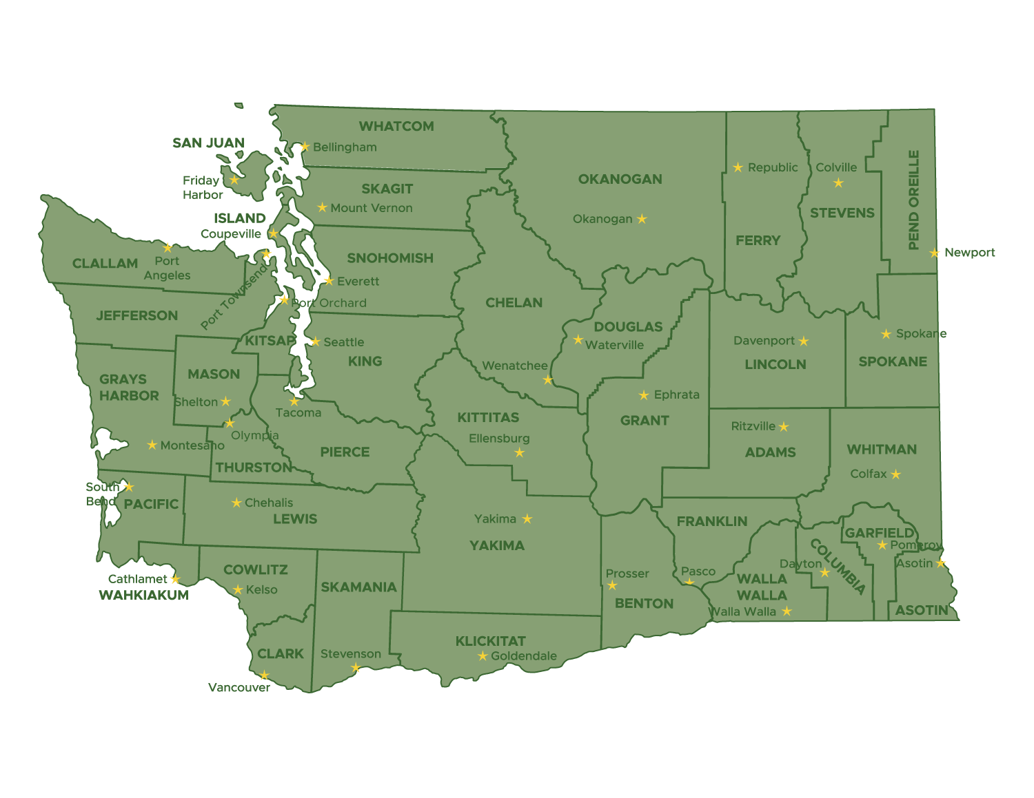
County Arterial Preservation Program (CAPP)
Who can use the County Arterial Preservation Program?
WAC 136-300-050 (5)
County must be in compliance with pavement management system requirements (WAC 136-70)
County Engineer must submit annual County Arterial Preservation Program plan (WAC 136-300-060
Work conducted with CAPA funds is in conformance with allowable activities (WAC 136-300-070)

Slide 8
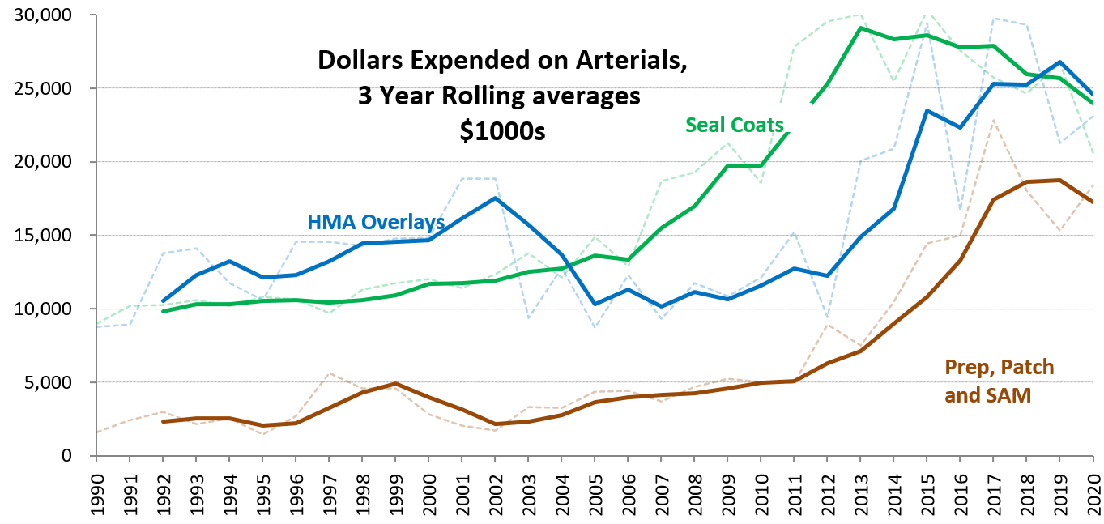
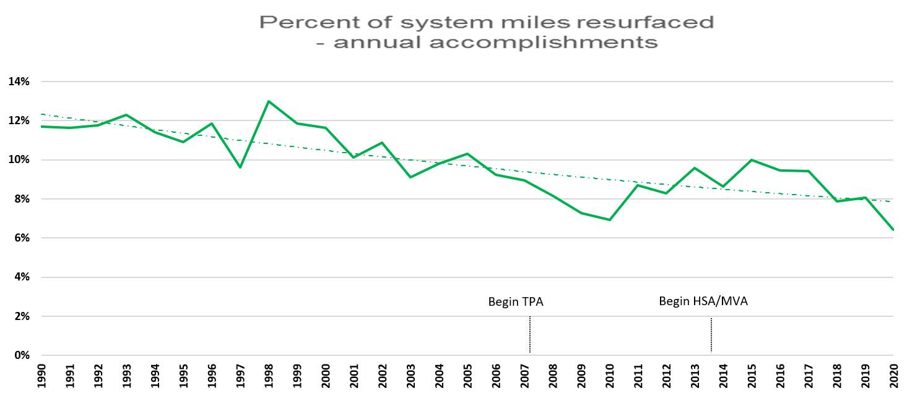
County Arterial Preservation Program (CAPP)
How does the County Arterial Preservation Program work?
Monthly funding distribution
Prepare County Arterial Preservation Program Plan (by December 31 – for upcoming year)
Conduct the work - work must be included in the Allowable Activities described in WAC 136-300-070
Prepare County Arterial Preservation Program Report (by April 1 – for previous year)

Slide 9
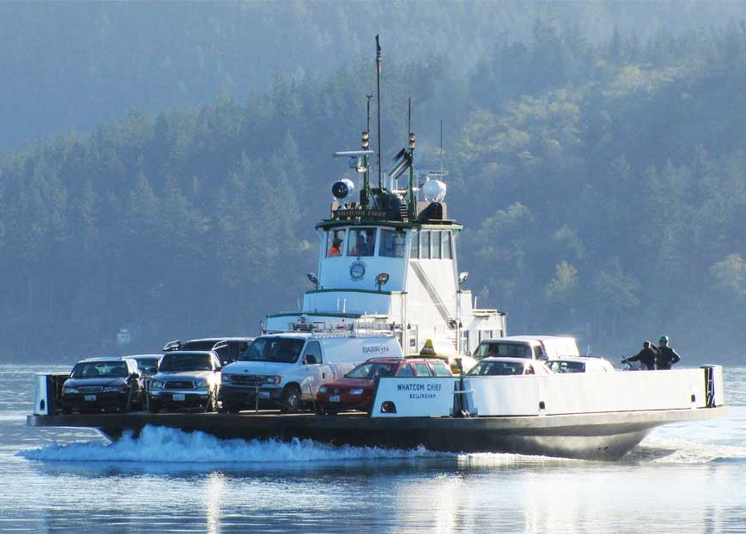
County Ferry Capital Improvement Program (CFCIP)
What is the County Ferry Capital Improvement Program?
Created by the Washington State Legislature to support capital improvements for county vehicle ferries
Funded by appropriation to CRAB out of the 19.2287% of the direct county MVA distribution of State fuel tax, per RCW 46.68.090 (2)(h)
Allowable work is specifically limited to capital improvements (WAC 136-400-030)

Slide 10
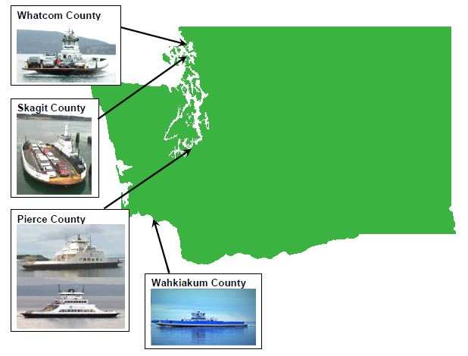
County Ferry Capital Improvement Program (CFCIP)
Who can use the County Ferry Capital Improvement Program?
WAC 136-400-020
Pierce, Skagit, Wahkiakum, Whatcom
Project must be in the county’s 6-year plan and the county’s 14-year ferry system plan
May only have one funded project at a time
Must have pursued other funding per RCW 47.56.725 (4)

Slide 11
County Ferry Capital Improvement Program (CFCIP)
How does the CFCIP Program Work?
Year A (or Earlier) Actions
Project planning and engineering
Year B Actions
County requests CRAB to issue a call for projects (spring meeting)
CRAB may act on this request at spring or summer meeting
If a call for projects is approved, project applications must be submitted no later than Dec 31
Year C Actions
Technical Review Committee prepares report no later than 30 days prior to the CRAB spring meeting
Board reviews report and may act on recommendation at spring or summer meeting
If approved, CRAB prepares funding request in agency biennial budget
Year D Actions
State Legislature reviews CRAB CFCIP budget request
If approved by Legislature and Governor, CFCIP funds become available for project expenditures beginning July 1, or upon execution of the CRAB/County contract
4 YEAR CYCLE
Year A
2020, 2024, 2028, etc
Year B
2021, 2025, 2029, etc
Year C
2022, 2026, 2030, etc
Year D
2023, 2027, 2031, etc

Slide 12
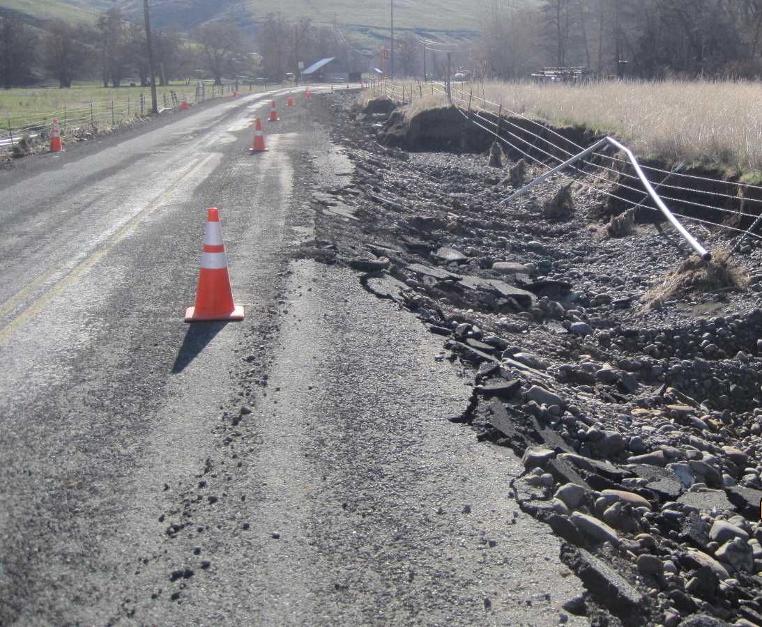
Emergency Loan Program (ELP)
What is the Emergency Loan Program?
Created in 2019 by the Washington State Legislature (RCW 36.78.130)
Revolving loan program
Funded with initial $1 million deposit in 2019 additional $2 million deposited in 2021
Funds may be requested by eligible county
Allowable work may be temporary or permanent repairs relating to identified emergency

Slide 13
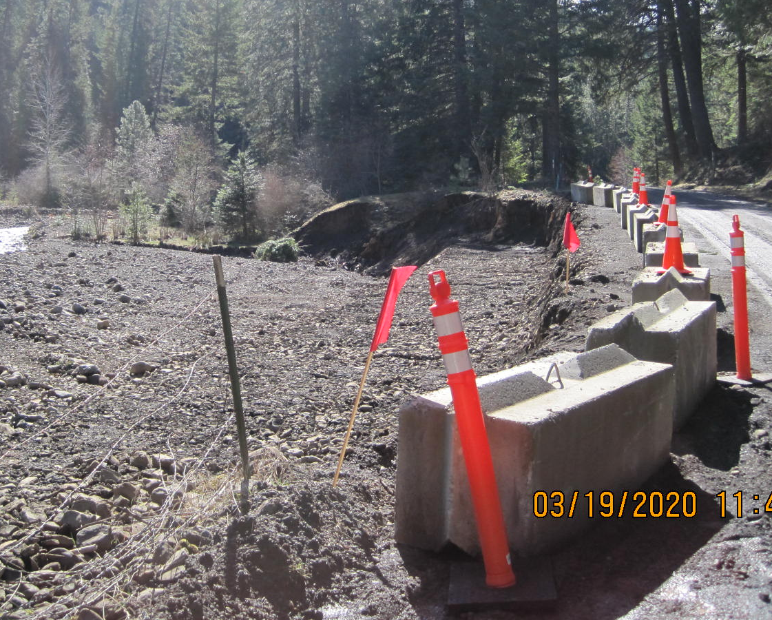
Emergency Loan Program (ELP)
Who can use the Emergency Loan Program?
RCW 36.78.130
Counties with a population of less than 800,000 as of April 1, 2019
Declared county, state, or federal emergency proclamation related to the event
WAC 136-500-040
Any county eligible to participate in the Rural Arterial Program
County must have current certificate of good practice

Slide 14
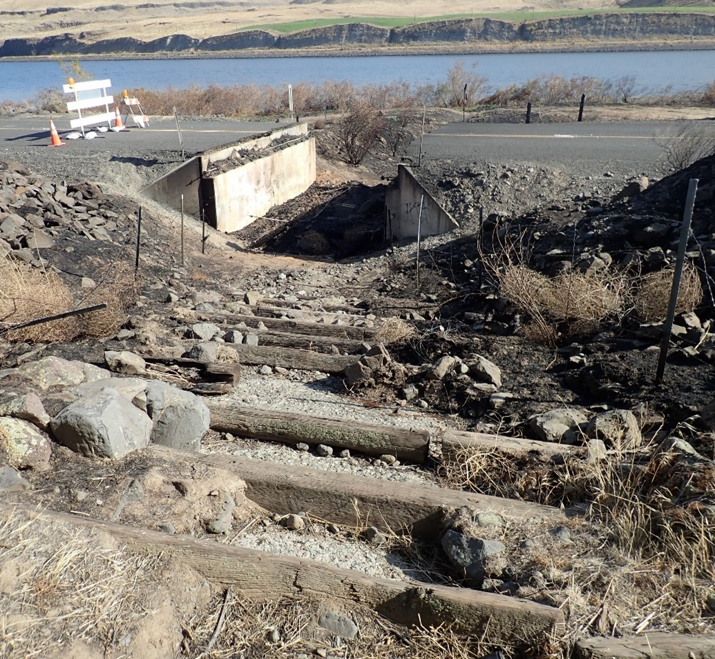
Emergency Loan Program (ELP)
How does the Emergency Loan Program work?
Declaration of emergency relating to an event that has damaged county road or bridge
Eligible county may request emergency loan for temporary or permanent repairs
Maximum request amount is $2 million or half of the available fund balance, whichever is less
CRAB Executive Director is authorized to offer and execute contract meeting these limits
Loan is to be paid back within two years
Quarterly billings and status updates
CRABoard must report to the legislature

Slide 15
2404 Chandler Court SW, Suite 240 Olympia, WA 98502 360.753.5989 crab.wa.gov
Jane Wall
Executive Director jane.wall@CRAB.wa.gov
360.350.6078
Drew Woods, PE
Deputy Director drew.woods@CRAB.wa.gov
360.753.5989
Derek Pohle, PE
Support, Training and derek.pohle@CRAB.wa.gov
Compliance Manager 360.350.6082
Steve Johnson, PE
Grants Program steve.johnson@CRAB.wa.gov
Manager 360.350.6081
Mike Clark, CET
Road Systems mike.clark@CRAB.wa.gov
Inventory Manager 360.350.6084

